Slide 1
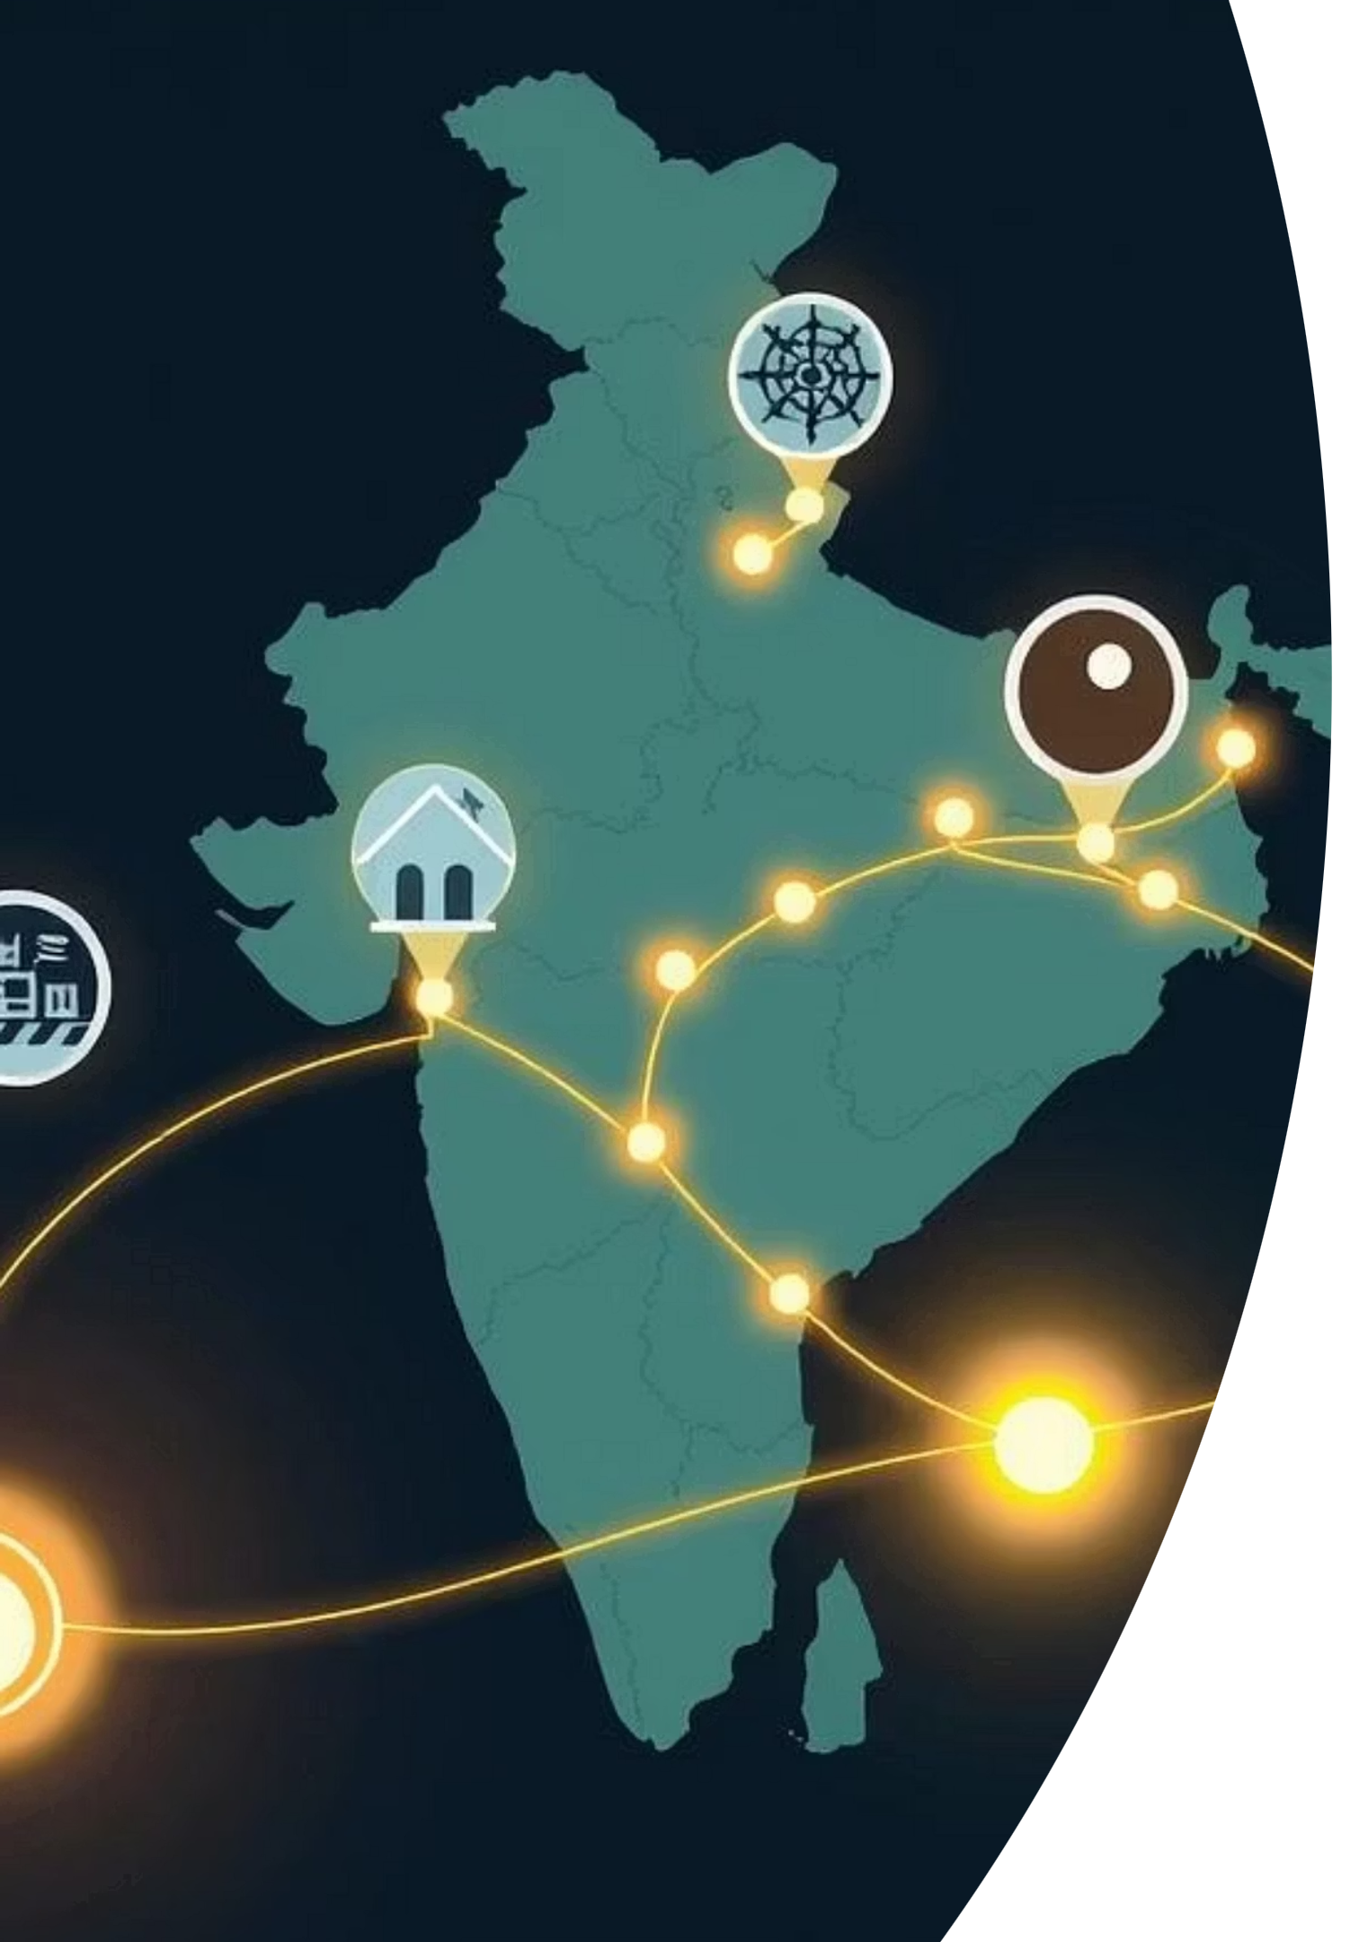
SafeRoute: Your Intelligent Guide to Safety During Natural Calamities
Empowering individuals in India with real-time risk assessment and personalized, safe evacuation routes during floods and earthquakes.

Slide 2
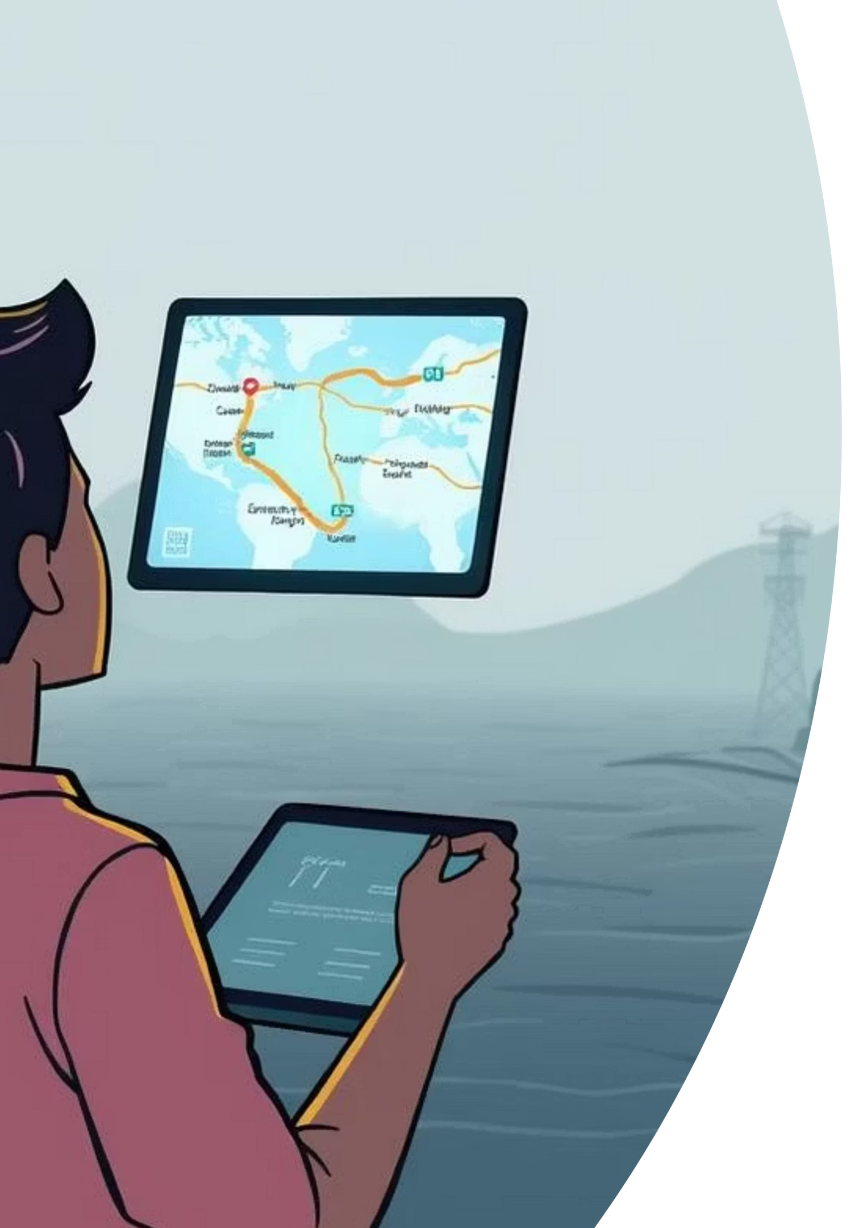
Introduction to SafeRoute
Natural calamities, such as floods and earthquakes, pose an increasing threat globally, especially in vulnerable regions like India. Traditional evacuation plans are often static and slow to adapt to rapidly changing conditions.
SafeRoute is a dynamic, intelligent web-based model providing real-time risk assessment and personalized safe evacuation routes, designed to enhance community resilience.

Slide 3

SafeRoute's Mission
Our single-page web application focuses on critical disaster preparedness and rapid response within India. Users simply enter their current location to receive vital information:
AI-calculated probability of disaster impact, providing a clear understanding of immediate risks.
Optimized, safe routes to designated evacuation areas, leveraging advanced mapping and real-time data.
We aim to transform disaster response, fostering a more prepared and resilient community through AI-powered guidance and proactive safety measures.

Slide 4

Dynamic Real-Time Intelligence for Unprecedented Safety
Live Pathing & Rerouting
Experience continuous GPS tracking and instant, dynamic recalculation of the safest route if new hazards appear mid-journey, ensuring you're always on the optimal path to safety.
Crowd Detection Engine
Our anonymized user data detects potential bottlenecks and congestion in real-time, guiding users away from crowded areas and preventing panic during evacuations.
Immediate Alert Notifications
Receive critical, actionable alerts instantly via push notifications, keeping you informed and ahead of developing situations.

Slide 5
Core Features: Empowering Every User
Simple Location Input
AI-Powered Risk Assessment
Easily enter your Indian city, district, or precise coordinates to quickly access personalized safety information.
Our system analyzes Indian Meteorological Department (IMD) data, historical disaster patterns, and real-time conditions to assess risks for major Indian natural disasters, including floods and earthquakes.
AI-Generated Emergency Guidance
Smart Evacuation Routes
Receive personalized advice on what to do, where to go, what to pack, and what precautions to take, aligned with NDMA guidelines.
Leveraging OpenStreetMap data and real-time hazard information, SafeRoute recommends the safest and most efficient evacuation paths to designated shelters.

Slide 6


Frontend Technologies: Building a Seamless User Experience
React.js with Vite
Tailwind CSS & DaisyUI
A modern JavaScript library for building fast, interactive Single Page Applications (SPAs). React allows for modular, component-based UI development, improving code reusability and maintainability. Vite serves as a lightning-fast development server and build tool, providing instant hot-reloading and optimized production builds for an efficient development workflow.
Tailwind CSS is a utility-first framework that allows rapid styling with pre-defined classes (e.g., text-center, rounded-lg, bg-blue-500). DaisyUI extends Tailwind by offering pre-designed, responsive UI components like buttons, alerts, cards, and modals, ensuring visual consistency and accessibility across the application.

Slide 7
Backend & AI Technologies: Powering Intelligent Safety
Python/FastAPI or Flask
Public APIs
AI (LLM Service Providers)
Handles all routing, complex logic, and secure server communication. FastAPI is preferred for its high performance, leveraging asynchronous support for efficient data processing and responsiveness.
We integrate with APIs from IMD, Open-Meteo, and OpenWeatherMap for crucial weather and disaster data. OpenStreetMap's Overpass API and OpenRouteService provide essential infrastructure details and facilitate safe evacuation route generation.
Utilizes Large Language Models (LLMs) for sophisticated risk predictions and generates personalized, NDMA-aligned guidance, such as "Avoid flood zones," "Pack essentials," and "Locate nearest shelter."
Beyond the core, we implement WebSockets/Polling for persistent, low-latency communication to deliver real-time location and alert data. Advanced Geolocation leverages mobile device GPS and browser Geolocation APIs for precise user position data. Data Aggregation involves secure, server-side processing to handle and anonymize mass user location data, crucial for the Crowd Detection feature.

Slide 8
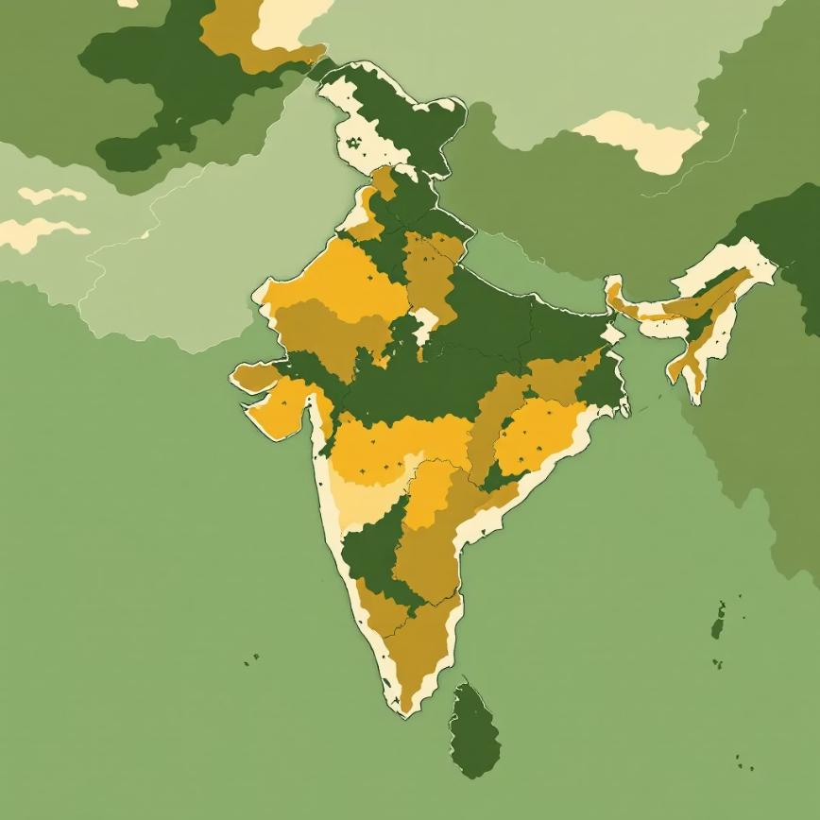

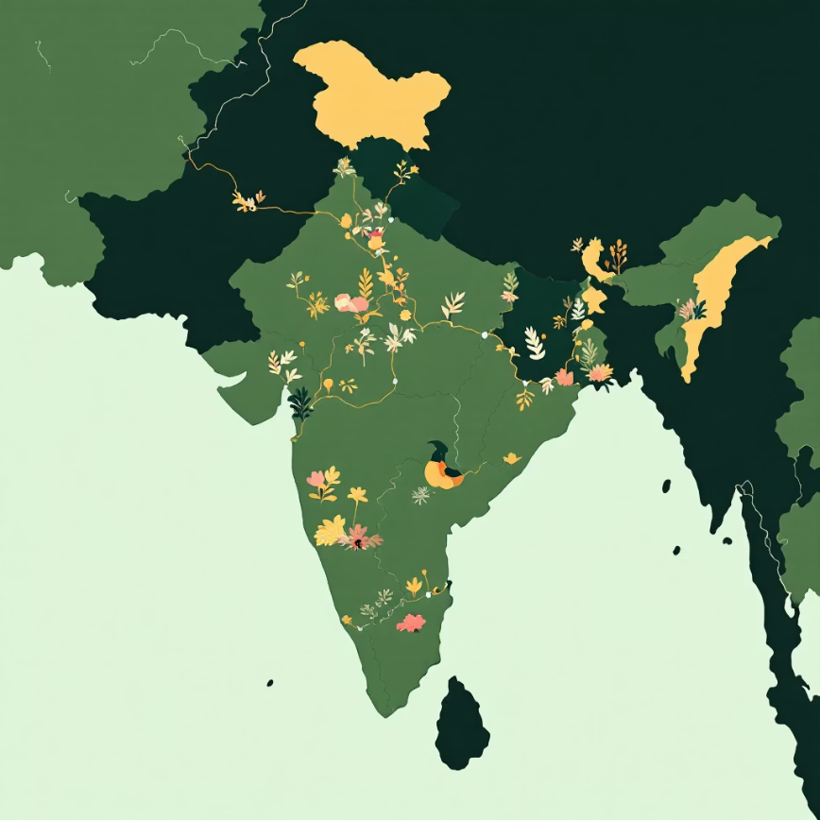
Data Sources & Mapping: Comprehensive and Reliable Information
Geocoding & Weather
Mapping & Routing
Additional Data
Indian Meteorological Department (IMD) API: Official weather and disaster forecasts.
OpenStreetMap (OSM) with Leaflet.js: Detailed, open-source mapping for India.
ISRO satellite data: Provides critical geospatial and disaster monitoring imagery.
Open-Meteo & OpenWeatherMap API: Supplemental real-time weather data.
OpenStreetMap Overpass API: Advanced querying of OSM data for specific infrastructure.
NDMA guidelines: Ensures all emergency guidance is official and effective.
OpenRouteService or OSRM: Optimized routing algorithms for safe path generation.

Slide 9
User Flow: Getting Critical Safety Information
1. Access & Input
2. Initiate Calculation
Users navigate to the SafeRoute web application and input their current location, either by typing a city/district or allowing precise GPS coordinates.
With a single click on "Confirm location," the user triggers the backend processing to assess their safety.
3. Backend Processing
4. Display Results
The system geocodes the location, queries IMD and other weather APIs, and the LLM calculates the disaster risk. Concurrently, OSM identifies evacuation centers, and a safe evacuation route is calculated.
The frontend rapidly displays the calculated risk level, an interactive map showcasing the personalized safe route, and AI-generated emergency guidance.

Slide 10
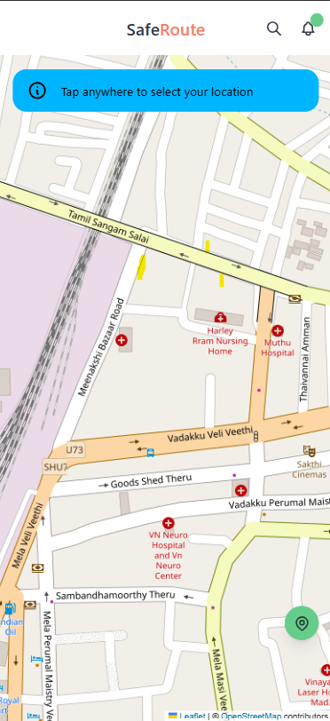
User Flow: Interactive Display for Informed Decisions
The SafeRoute frontend provides a comprehensive and intuitive display, ensuring users have all necessary information at their fingertips during a crisis:
Clear risk level and potential disaster type, allowing for immediate understanding of the threat.
An interactive map prominently featuring the user's location, the nearest safe evacuation center, and the personalized, dynamic safe route.
AI-generated emergency guidance and real-time safety recommendations, adapting to changing conditions and providing actionable advice.

Slide 11
Conclusion:
SafeRoute leverages real-time data, powerful AI, and comprehensive mapping for hyper-local disaster preparedness in India.
It's a robust, user-friendly system providing immediate, personalized insights and actionable evacuation strategies.
More than a map, SafeRoute is a vital instrument for informed decision-making and saving lives, building more resilient communities.

